Slide 1




Design and Evaluation of
Hierarchical Rings with Deflection Routing
Rachata Ausavarungnirun, Chris Fallin, Xiangyao Yu, ​
Kevin Chang, Greg Nazario, Reetuparna Das,
Gabriel H. Loh, ​Onur Mutlu​
​

Slide 2
Executive Summary
Rings do not scale well as core count increases
Traditional hierarchical ring designs are complex and energy inefficient
  Complicated buffering and flow control
Solution: Hierarchical Rings with Deflection (HiRD)
  Guarantees livelock freedom and delivery
  Eliminates all buffers at local routers and most buffers at bridge routers
HiRD provides higher performance and
energy-efficiency than hierarchical rings
HiRD is simpler than hierarchical rings
Notes:
First, let me go over a brief summary of this talk.
We observed that a ring interconnect, which is a commonly used design in modern systems nowadays, does not scale well as the number of cores increases.
Previous work has proposed one possible solution, which is a hierarchical ring, that can provide good performance compared to a single ring. However, we observed that previously proposed hierarchical design is complex and energy inefficient due to complicated buffering and flow control.
In this work, we propose a solution called “hierarchical ring with deflection” or HiRD, which provides livelock freedom and guarantees delivery
Additionally, our design, HiRD provides higher performance and energy efficienct and it is also simpler than hierarchical ring designs

Slide 3
Outline
Background and Motivation
Key Idea: Deflection Routing
End-to-end Delivery Guarantees
Our Solution: HiRD
Results
Conclusion
Notes:
This is the outline of this talk. I will start with the background and the motivation behind this work.

Slide 4
Scaling Problems in a Ring NoC
As the number of cores grows:
  Lower performance
  More power
Notes:
In modern system nowadays, where there are several CPU cores connected with each other. A ring is typically used to provide communication between cores. However, as the number of cores grows, sending a packet from one end to the other will be slower and cost more power.

Slide 5
Alternative: Hierarchical Designs
Packets can reach far destination in fewer hops
Local Ring (Level 0)
Global Ring (Level 1)
Notes:
Previous work has proposed the solution to the performance scalability problem by using a hierarchy design.
In this example, there are sixteen CPU cores in the system. First, the hierarchical design will connect each region of the cores together using a single ring. We called these rings a “local ring” or a lower level ring. Afterward, each local rings are connected onto a global ring using a bridge router. This global ring can have multiple level. With the global ring, packets from one node can reach a far-away location in fewer number of hops compared to single ring.

Slide 6
Single Ring vs. Hierarchical Rings
A hierarchical design provides
better performance as the network scales
Notes:
Now let me show you the performance of the hierarchical design. In this plot, the y-axis shows the performance of a system and the x-axis shows the performance for each design at different network sizes. As shown here, the hierarchy design provides better performance as the size of the network gets bigger.

Slide 7
Complexity in Hierarchical Designs
Complex buffering and flow control
Notes:
However, hierarchical ring also comes at a cost → they are more complicated than a single ring. There need to be several buffering at the global ring. Additionally, to support a flow control, there need to be more buffers at each local rings.

Slide 8
Single Ring vs. Hierarchical Rings
Design complexity increases power consumption
Notes:
The complicated buffering and flow control has an impact on the power efficiency of the network. In this plot, the y-axis shows the network power, lower is better. The x-axis shows the network power of different ring designs including the hierarchical ring. This plot shows that the design complexity, which are complicated buffering and flow control I mentioned in the previous slide, increases the power consumption.

Slide 9
Our Goal
Design a hierarchical ring that
has lower complexity
without sacrificing performance
Notes:
As a result, our goal of this paper is to design a hierarchical ring that has lower complexity without sacrificing performance

Slide 10
Outline
Background and Motivation
Key Idea: Deflection Routing
End-to-end Delivery Guarantees
Our Solution: HiRD
Results
Conclusion
Notes:
Now that I have explained the background and the motivation behind our work, we will continue with the key ideas on how can we make the hierarchy design simpler without sacrificing performance.

Slide 11
Key Idea
Eliminate buffers
Use deflection routing
  Simpler flow control
Notes:
The key idea is to eliminate buffers. Additionally, we will use deflection routing, which is a simple flow control, on hierarchical ring. Now I will show you how buffers can be eliminated.

Slide 12
Local Router
Key functionality:
  Accept new flits
  Pass flits around the ring
Local West
Local East
Core
Notes:
First, let’s look at the local router. In a buffered hierarchical ring designs proposed before. Buffering are needed in order to make sure that flits contending for the same output can be stored.
In a more general case, the key functionality of the local ring is to accept new flits while able to pass flits around the ring. We will show you on the next slides how this can be done without buffers.

Slide 13
Eliminating Buffers in Local Routers
Local West
Local East
Core
Notes:
First, when buffers are eliminated, (click until the buffer are gone and go to the next slide)

Slide 14
Eliminating Buffers in Local Routers
Flits can enter the ring if the output is available
Ejector
Local West
Local East
No Buffer
Core
Simpler Crossbar
Notes:
The router needs to be able to pass flits around the ring. Additionally, the routers need to be able to accept new flits into the ring. This can be done without buffering using a simpler crossbar design using two muxes.

Slide 15
Deflection Routing
Ejector
Local West
Local East
Deflected
Core
Notes:
In order to make sure flits can be passed around, we use deflection routing. When there are two flits contending for the same output port, one flit will get deflected onto the other output port as shown in this example. This is how the local buffer can be designed without buffering. As you can see here, the router is much simpler.

Slide 16
Bridge Router
Global Ring
West
East
Crossbar
West
East
Local Ring
Notes:
Now, let’s look at the bridge router design, which connects several rings together. First, the bridge router will take four inputs and outputs from the local and global ring. Similar to the local ring, the global ring needs buffering in order to store flits that contend for the same output port. Additionally, there need to be another crossbar that connects each input to its output.

Slide 17
Eliminating Buffers in Bridge Routers
Global Ring
West
East
Crossbar
West
East
Local Ring
Notes:
In this work, we would like to simplify our design and eliminate as many buffers as possible (click until we reach the next slide)

Slide 18
Eliminating Buffers in Bridge Routers
Global Ring
West
East
Simpler Buffering
Fewer Buffers
Simpler Crossbar
West
East
Local Ring
Notes:
First, there need to be a connection that connect each inputs to the designated output ports. In order to support this, we implement the router with four muxes and two simple 2-input, 2-output crossbars, which is much simpler than a 4-input 4-output crossbar. Additionally, we observed that the bridge router can become a hotspot. As a result, we added a very simple FIFO into the input to the crossbar. In our evaluation, we observed that 4 buffers is enough to mitigate congestion problem.

Slide 19
Outline
Background and Motivation
Key Idea: Deflection Routing
End-to-end Delivery Guarantees
Our Solution: HiRD
Results
Conclusion
Notes:
Now that I have explained how we eliminate buffering. We will show how we guarantee the end-to-end delivery under deflection routing.

Slide 20
Livelock in Deflection Routing
Injection starvation
Ring
Unable to inject
Starved Flit
Src
Notes:
First, let me show three issues that come with deflection routing that can cause livelock. The first issue is the injection starvation, which I will show in an example here.
Suppose that there is a ring connecting four nodes together, and let us focus on the buttom node where there is one flit waiting to be injected into the ring. Let say that there are two additional flits coming from its neighbor at every single cycle. In this case, it is possible that both incoming flits will not eject and move along in the ring. This will disallow the flit from the source from injecting into the network and become starved.

Slide 21
HiRD: Injection Guarantee
Throttling provides injection guarantee
After 150 cycles: All nodes stop injecting flits
Ring
Ring
Unable to inject
Starved Flit
Throttled Router
Src
Notes:
In order to provide injection guarantee, we implement a mechanism where, after a flit unable to inject itself into the ring for some amount of cycles, which we set to 150 cycles in our work, all other node in the ring will stop injecting flits into the ring. This means that eventually all flits in the ring will be drained and the starved flit will eventually be able to inject into the ring. Thus, we provide injection guarantee.

Slide 22
Livelock in Deflection Routing
Transfer starvation
Ring
Unable to Transfer
Starved Flit
Transfer FIFO
Notes:
Now, let us look at the second issue, which is called transfer starvation. Let us look at this example where there is a flit that want to exit the ring and goes into the transfer FIFO, which is full at the moment, in order to move on to the next ring. In this case, suppose that the next instance the transfer FIFO slot is available, it is possible that there are other flits incoming from another node wanting to be injected into the transfer FIFO, preventing the red flit from injecting itself into the transfer FIFO and get deflected around the ring. The red flit can potentially ended up being deflected forever causing a problem we called transfer starvation.

Slide 23
HiRD: Transfer Guarantee
Reservation provides transfer guarantee
After 10 looparounds
Ring
Starved Flit
Reserved Slot
Transfer FIFO
Notes:
In order to solve the transfer starvation, we implement a mechanism where if a flit is deflected around the loop a certain amount of time, which we set to 10 in our evaluation. Whenever the next time a transfer FIFO slot is available, the first available FIFO slot will be reserved for the starved flit, allowing the starved flit to move on into the transfer FIFO, providing transfer guarantee. In the worst case, this reservation preriod will happen until all the flits in the ring arrive at its transfer FIFO.

Slide 24
Ejection Guarantee
Provided by a prior work
Re-transmit once [Fallin et al., HPCA’11]
  Drop a flit if there is no available slot
  Reserve a buffer slot at the destination if
  a flit was dropped
Notes:
Lastly, the remaining problem is that we have to ensure that flit can eventually eject itself once it reaches the destination. In this case, we borrow a mechanism proposed by Fallin et al. in HPCA 2011 called “retransmit-once”. In re-transmit once, if a flit cannot eject itself at the destination and got dropped, a buffer slot will be reserved at the destinating ensuring that the next time this same flit got to the destination, this flit can use the reserved buffer slot and eject itself.

Slide 25
End-to-end Delivery Guarantees
Ejection Guarantee
dest
Local
Ring
Global Ring
Local
Ring
Injection Guarantee
Transfer Guarantee
Transfer Guarantee
Injection Guarantee
src
Injection Guarantee
Notes:
In this example, I will show a general idea of how we provide end-to-end delivery guarantees. Let say that there are two local rings connected by a global ring. Let’s say that a flit is injected from the source, shown in the figure, and would like to reach the destination on another ring, shown in the figure. Injection guarantee will ensure that this flit can inject itself into the local ring. Additionally, transfer guarantee will ensure that a flit can move from one ring to another and finally arrive at the destination as shown in this example.

Slide 26
Outline
Background and Motivation
Key Idea: Deflection Routing
End-to-end Delivery Guarantees
Our Solution: HiRD
Results
Conclusion
Notes:
Now that I have explained how we provide end-to-end guarantees. I will go over the overview of our design, HiRD.

Slide 27
An Overview of HiRD
Deflection routing
  Simpler flow control
  Simpler crossbars and control logics
No buffers in the local rings
  Simpler and faster local routers
Simpler bridge routers
  Lower power, less area and simpler to design
Provides end-to-end delivery guarantees
  Injection guarantee by throttling
  Transfer guarantee by reservation
Notes:
First, HiRD uses deflection routing. Second HiRD eliminate all the buffers in every local ring and HiRD simplify the bridge router design by eliminating most buffers and uses simpler crossbars. Lastly, HiRD provides end-to-end delivery guarantess. Injection guarantee through thorttling and transfer guarantee through reservation.

Slide 28
Putting It All Together
Deflection routing
  Simpler flow control
  Simpler crossbars and control logic
No buffers in the local rings
  Simpler and faster local routers
Simpler bridge routers
  Lower power, less area and simpler to design
Provides end-to-end delivery guarantees
  Injection guarantee by throttling
  Transfer guarantee by reservation
Notes:
Putting everything together, deflection routing provides simpler flow control and simpler crossbar and control logic. Eliminating buffers provide simpler and faster local routers as well as lower power, less area and simpler local and bridge router designs. End-to-end guarantee ensures that all flits will eventually arrive at its destination.

Slide 29
Outline
Background and Motivation
Key Idea: Deflection Routing
End-to-end Delivery Guarantees
Our Solution: HiRD
Results
Conclusion
Notes:
Now that I have explained the mechanism of “HiRD”, I would like to show the key results.

Slide 30
Methodology
Cores
  16 and 64 OoO CPU cores
  64 KB 4-way private L1
  Distributed L2
Network
  1 flit local-to-global buffer
  4 flits global-to-local buffers
  2-cycle per hop latency for local routers
  3-cycle per hop latency for global routers
60 workloads consisting of SPEC2006 apps
Notes:
We perform our evaluation on a 16 and 64 OoO CPU cores with 64KB L1 and distributed L2. HiRD uses 5 total buffers in each bridge routers and we implement the local routing with 2 cycles latency and the bridge router with a 3 cycles latency. We evaluated our design on 60 different workloads consisting of different number of SPEC2006 applications.

Slide 31
Comparison to Previous Designs
Single ring design
  Kim and Kim, NoCArc’09
  64-bit links
  128-bit links
  256-bit links
Buffered hierarchical ring design
  Ravindran and Stumm, HPCA’97
  Identical topology
  Identical bisection bandwidth
  4-flit buffers in both local and global routers
Notes:
We compared HiRD with two previously proposed designs. The first design is a single ring designed proposed by Kim and Kim in NoCArc’09. We also vary the link bandwidth of these designs from 64 bits to 256 bits. Additionally, we compare HiRD with the most recent buffered hierarchical ring design proposed by Ravindran and Stumm in HPCA 1997. We set the buffered hierarchical ring design with the same topology, bisection bandwidth and use 4 flit buffers in both local and global routers.

Slide 32
Results: System Performance
1.9%
2.9%
Hierarchical designs provide better performance than a single ring on a larger network
HiRD performs better compared to buffered hierarchical rings due to lower latency in local routers and throttling
Notes:
In this graph, we show the system performance in the y-axis and the x-axis shows the performance of various design including the buffered hierarchical ring and HiRD. Compared to a buffered hierarchical ring, HiRD performs 1.9% better is a 4x4 case and 2.9% better in an 8x8 case. This performance gain is due to the lower local router latency, from 3 cycles to 2 cycles, and throttling. Additionally, both heirarchical designs perform better as the size of the network gets larger.

Slide 33
Results: Network Power
46.6%
15%
Hierarchical designs consume much less power than the highest-performance single ring
2) Routers and flow control in HiRD are simpler than
routers in buffered hierarchical rings
Notes:
In this graph, we show the network power on the y-axis and the x-axis shows the power of different ring designs including the buffered hierarchical ring and HiRD at different network size. Compared to a buffered hierarchical ring design, HiRD reduces network power by 46.6% in the 4x4 case and 15% in an 8x8 case because routers in HiRD are simpler, has much lower number of buffers and employs a simpler deflection flow control. HiRD also consume much less power than single ring designs due to reductions in links power.

Slide 34
Router Area and Critical Path
16-node network with 8 bridge routers
Verilog RTL design using 45nm Technology
HiRD reduces NoC area by 50.3% compared to a buffered hierarchical ring design
HiRD reduces local router critical path by 29.9% compared to a buffered hierarchical ring design
Notes:
Lastly, we have evaluated the network area and router critical path on a 16-node setup with 8 bridge router using Verilog RTL on a 45nm library. We doung that HiRD reduces the NoC area by 50.3% compared to a buffered hierarchical ring design and reduces the local router critical path by 29.9% compared to a bufferd hierarchical ring design.

Slide 35
Additional Results
Detailed power breakdown
Synthetic evaluations
Energy efficiency results
Worst case analysis
Techical Report:
  Multithreaded evaluation
  Average, 90th percentile and max latency
  Comparison against other topologies
  Sensitivity analysis on different link bandwidths and number of buffers
Notes:
Before we finish up the presentation, I would like to add that we also provide several additional results in the paper, which includes the detailed power breakdown, systhetic evaluations, energy efficiency results and the worst case analysis. Lastly, we also provide a technical report that contains multithreaded evaluation, average, 90th percentile, and maximum latency analysis, comparison against other topologies, which are mesh, bufferless mesh and flattened butterfly topologies, as well as sentivity analyses on different link bandwidths and different number of buffers.

Slide 36
Outline
Background and Motivation
Key Idea: Deflection Routing
End-to-end Delivery Guarantees
Our Solution: HiRD
Results
Conclusion
Notes:
Now I will conclude.

Slide 37
Conclusion
Rings do not scale well as core count increases
Traditional hierarchical ring designs are complex and energy inefficient
  Complicated buffering and flow control
Solution: Hierarchical Rings with Deflection (HiRD)
  Guarantees livelock freedom and delivery
  Eliminates all buffers at local routers and most buffers at bridge routers
HiRD provides higher performance and
energy-efficiency than hierarchical rings
HiRD is simpler than hierarchical rings
Notes:
We observed that a ring interconnect, which is a commonly used design in modern systems nowadays, does not scale well as the number of cores increases.
Previous work has proposed one possible solution, which is a hierarchical ring, that can provide good performance compared to a single ring. However, we observed that previously proposed hierarchical design is complex and energy inefficient due to complicated buffering and flow control.
In this work, we propose a solution called “hierarchical ring with deflection” or HiRD, which provides livelock freedom and guarantees delivery
Additionally, our design, HiRD provides higher performance and energy efficienct and it is also simpler than hierarchical ring designs

Slide 38
Design and Evaluation of
Hierarchical Rings with Deflection Routing
Rachata Ausavarungnirun, Chris Fallin, Xiangyao Yu, ​
Kevin Chang, Greg Nazario, Reetuparna Das,
Gabriel H. Loh, ​Onur Mutlu​
​

Slide 39
Backup Slides

Slide 40
Network Intensive Workloads
15 network intensive workloads
Notes:
Now we will present the performance on a network intensive workloads. We evaluate our design with 15 network intensive workloads.

Slide 41
System Performance
2.5%
5.6%
Deflections balance out the network load Thorttling reduces congestion
Notes:
First, let’s look at the system performance. In this plot, the y-axis shows the system performance and the x-axis shows the performance of different designs and network size. We observed that HiRD outperforms buffered hierarchical design by 2.5% on a 4x4 network and 5.6% on an 8x8 network. We observe that deflections and throttling help reducing the network congestion and distribute packets throughout the network.

Slide 42
Network Power
37%
11.9%
More deflections happen when
the network is congested
Notes:
This plot shows the network power. The y-axis shows the network power while the x-axis shows the different designs and network sizes. We observed that compared to a buffered hierarchical ring, HiRD consumes 37% less power in a 4x4 network and 11.9% lower power in an 8x8 network. We observed that the reason why the power saving of HiRD is lower in network intensive workloads is because there are more deflections. These additional deflections cause more power.

Slide 43
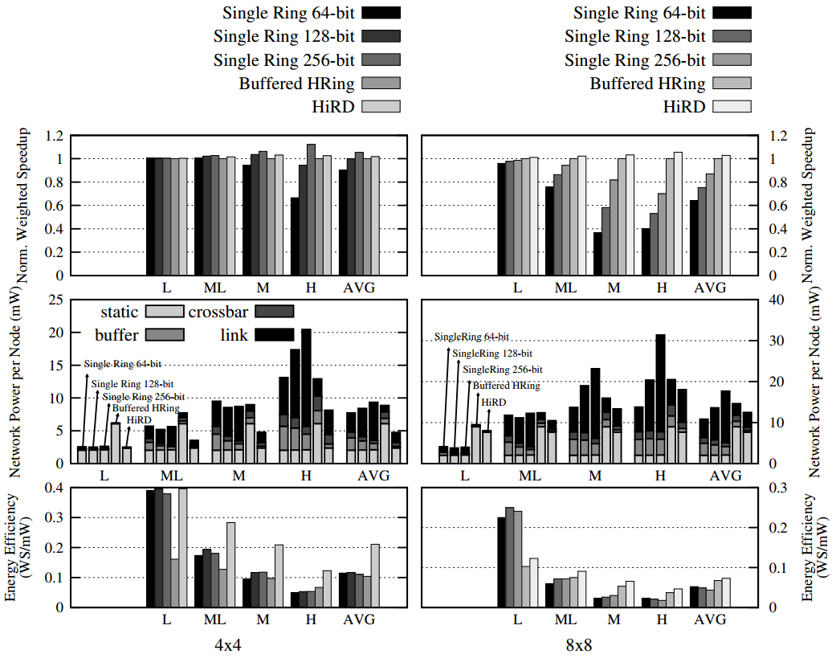
Detailed Results

Slide 44
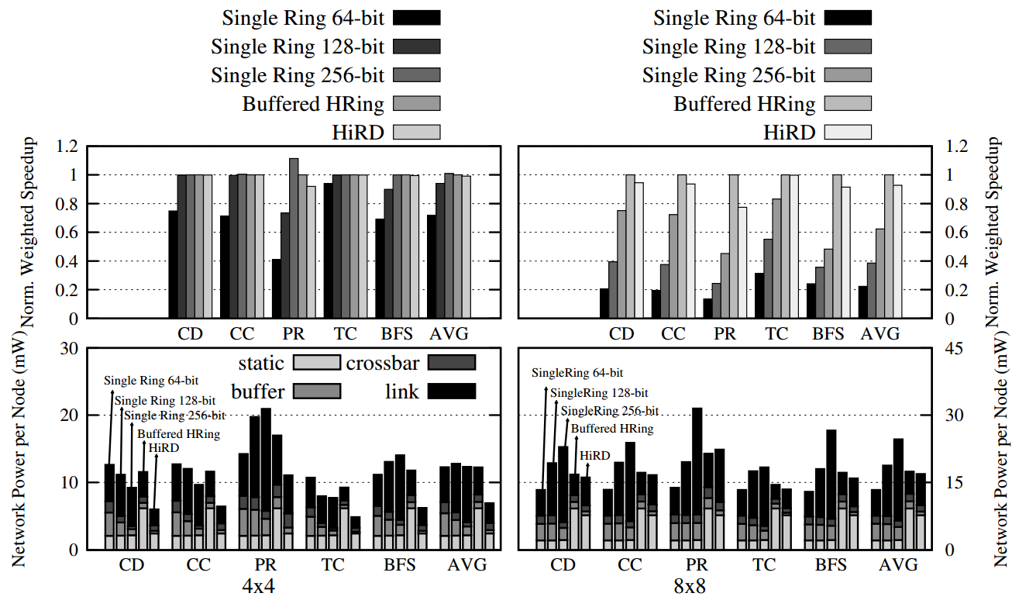
Multithreaded Applications

Slide 45
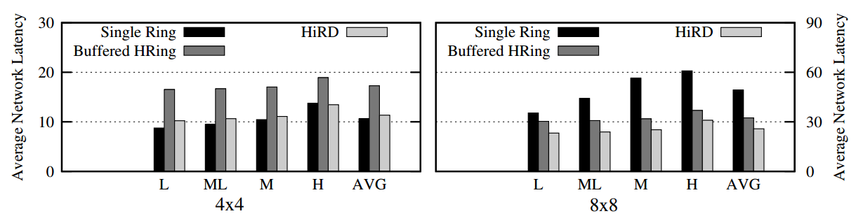
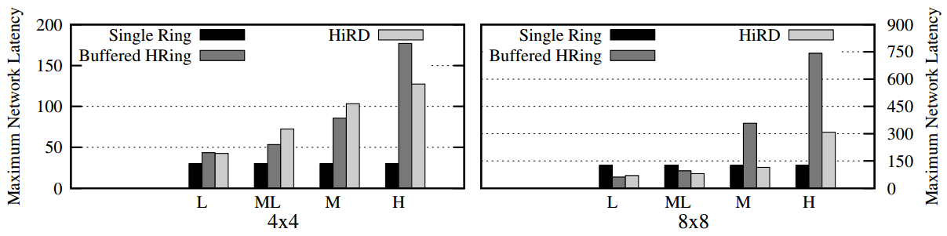
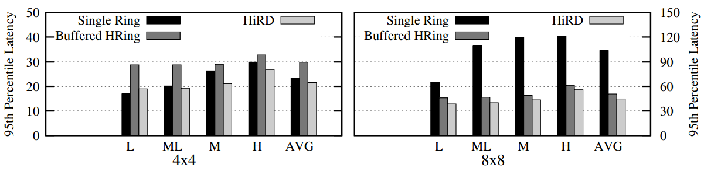
Network Latency

Slide 46
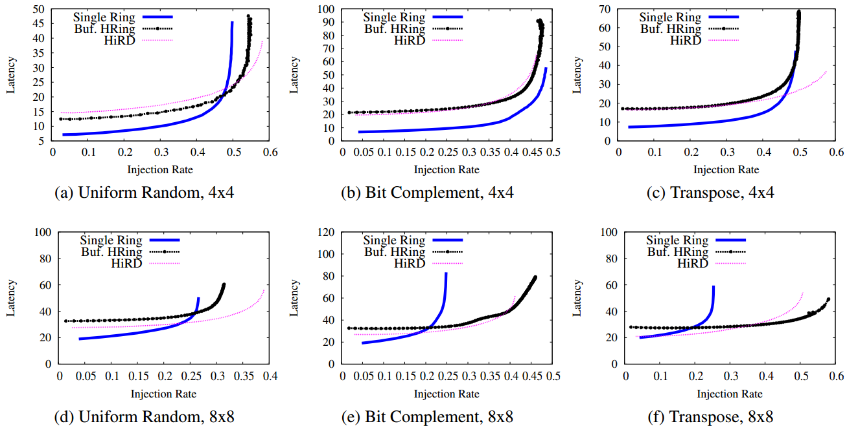
Synthetic Traffic Evaluations

Slide 47
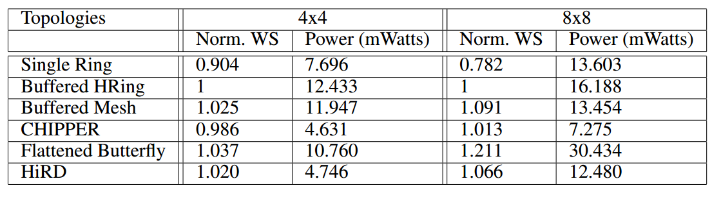
Topology Comparison

Slide 48
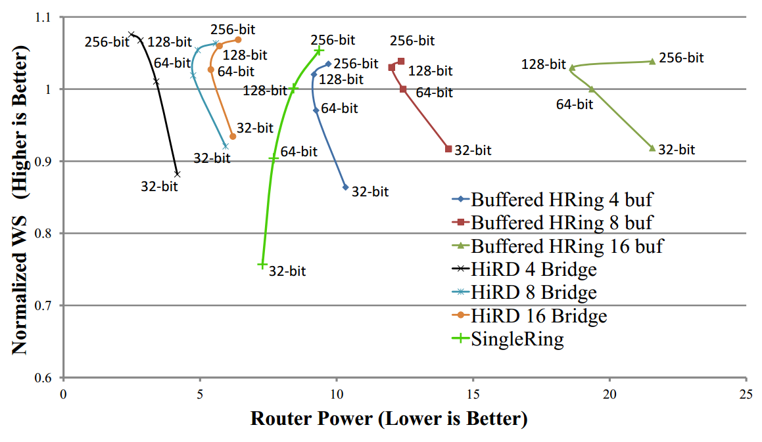
Sweep over Different Bandwidth

Slide 49
Packet Reassembly
Borrowed from CHIPPER [Fallin et al. HPCA’10]
  Retransmit-Once → Destination node reserves a buffer slot for a dropped packet
  Provides ejection guarantee

Slide 50
Other Optimizations
Map cores that communicate with each other a lot on the same local ring
  Takes advantage of the faster local ring routers

Slide 51
Related Concurrent Works
Clumsy Flow Control [Kim et al., IEEE CAL’13]
  Requires coordination between cores and memory controllers
Transportation inspired NoCs [Kim et al., HPCA’14]
  tNoCs require an additional credit network
  tNoCs have more complex flow control
  HiRD is more lightweight

Slide 52
Some Related Previous Works
Hierarchical Bus [Udipi et al., HPCA’10]
  HiRD provides more scalability
Concentrated Meshe [Das et al., HPCA’09]
  Several nodes share one router
  Used on meshed network
  Less power efficient than HiRD
Low-cost Mesh Router [J. Kim, MICRO’09]
  Specifically designed for meshes
  Does not solve issues in deflection-based flow control (HiRD does)

